Slide 1

COMPANY PROFILE

Slide 2
ABOUT US
We are an Auto Body Repair & Spray painting shop situated in Gauteng.
Our business is a BBBEE level 2.
We aim to support our community by bringing professionalism, discipline and culture to an industry that is in need of committed, honest and quality service delivery.
Our commitment is to our clients with whom we intend on forming lasting relationships.

Slide 3
OVERVIEW
Our team consists of qualified, experienced employees who are more than capable to provide exceptional body repair work and spray painting and tackle almost any imaginable repair and replacement.
We are in possession of the necessary equipment and have premises which includes spray booths for passenger vehicles and trucks.

Slide 4
mission
We are committed to accuracy and friendly service
Our aim is to gain our customers trust by providing free quotations, excellent workmanship, outstanding service and by being professional and cost effective at all times
To maintain our high quality service by aiming to improve upon customers expectations

Slide 5
vision
We strive to provide cost effective and efficient repairs, giving attention to quality and service
We are consistently measuring our quality, service and value, always placing our customers first
We make it our essence to ensuring satisfied customers back on the road as quickly as possible.

Slide 6
Vision chart
To strive for continued professionalism, and provide honest service with quality workmanship
To be at the forefront
To provide unique repair experience to customers

Slide 7
facilities
Panel beating
Specialised state of the art equipment, pulling and measuring systems, seam welding, thus ensuring precision repairs according to specifications
SPRAY PAINTING
Paint preparation area is dust–free environment thus ensuring a quality finish and guarantee on paint work
Our computer-aided paint mixing and matching system allows for colour matching to be correct

Slide 8
Services we offer
Regular updates on progress of repairs
Quotations at your premises
Free collect and drop off
Secured storage of your vehicle whilst on the premises
Towing arrangements

Slide 9
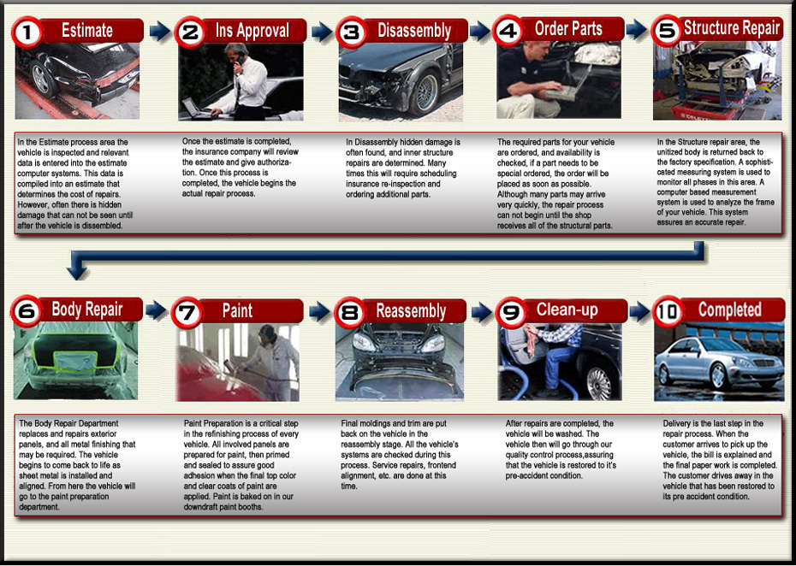
process

Slide 10
Contact us
119 Northern road, Nigel, 1491
Email. Khuzwayo.dm@gmail.com
Office : 011 814 1466
Cell: 078 763 6918

